Slide 1
Classification of Plant Leaf Diseases Using Different Convolutional Neural Network Models
Supervised By
Md. Hasnat Riaz
Assistant Professor
Department of CSTE, NSTU
Presented By
Partha Pratim Mazumder
ASH1701033M
Monuar Hossain
ASH1701024M
Session: 2016-2017

Slide 2
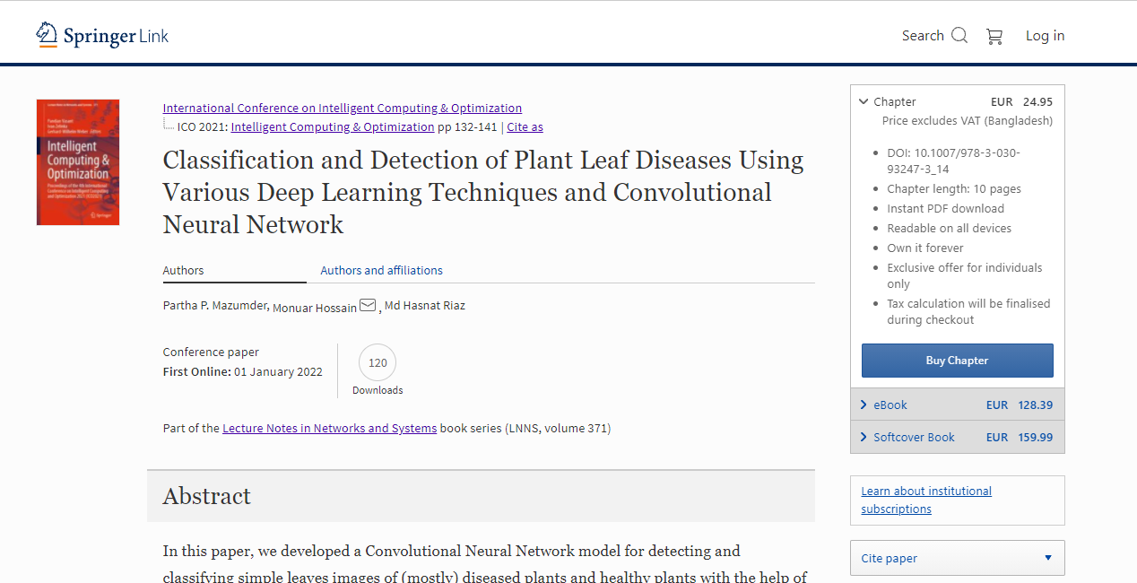

Slide 3
Introduction
Plant diseases have a devastating effect on agricultural products. The monetary loss caused by plant diseases is estimated to be $30–50 billion annually [1].
As detecting plant diseases are difficult without an expert’s knowledge fast and automated diagnostic methods are highly desired in agricultural fields
In general, plant diagnosis by experts is expensive, and viral plant diseases are occasionally missed or misdiagnosed because their symptoms are difficult to identify.
To improve the diagnostic results, several studies on machine learning-based automated plant diagnosis have been conducted.
Recently, CNN have demonstrated excellent performance in large scale general image classification tasks[2], traffic sign recognition[3] , leaf classification[4], and so on.

Slide 4
Problem statement
In our method of detecting plant disease the previous dataset contains 15 classes of 20,639 images and an accuracy around 96.44%.
But we worked on the dataset of 38 classes of 54,306 images which can help the disease detection more accurately.
Also, we have used different transfer learning techniques like MobileNetV2, InceptionV3, ResNet50, VGG19, Xception to check which model works better on the given data.

Slide 5
Objectives
Develop a system that capable to dig up and appoint the different type of plant diseases based on blobs detection and statistical analysis.
Analyzing different types of plant diseases as efficiently as possible.
Predicting the possible pathogens of a certain leaf analyzing it’s affected region.
To let people know the possibility of a certain malady only analyzing raw images from them.

Slide 6
Literature Review
Suhaili Kutty et al. [5] proposed the process to classify Anthracnose and Downey Mildew, watermelon leaf diseases. Their proposed method achieved 75.9% of accuracy based on its RGB mean color component.
The goal of Sanjeev Sannaki et al. [6] is to diagnose the disease using image processing and artificial intelligence techniques on images of grape plant leaf. They classify mainly two diseases, downy mildew and powdery mildew of grape leaf.
Akhtar et al. [7] have used the support vector machine approach for the classification and detection of rose leaf diseases as black spot and anthracnose

Slide 7
Continue…
Usama Mokhtar et al. [8] described technique of Tomato leaves diseases detection and diseases are: Powdery mildew and Early blight. Image preprocessing involved various techniques such as smoothness, remove noise, image resizing, image isolation
Bhog and Pawar [9] have incorporated the concept of neural network for the classification of cotton leaf disease analysis. For segmentation, K-means clustering has been used.

Slide 8
Description of data
We inspect total 54,306 images of plant leaves, which have a spread of 38 class labels allotted to them.
We make the sizes of the images to 256x256 pixels
Base learning rate is 0.001
Batch size is 32
Total number of epoch 55
Optimizer : ADAM

Slide 9
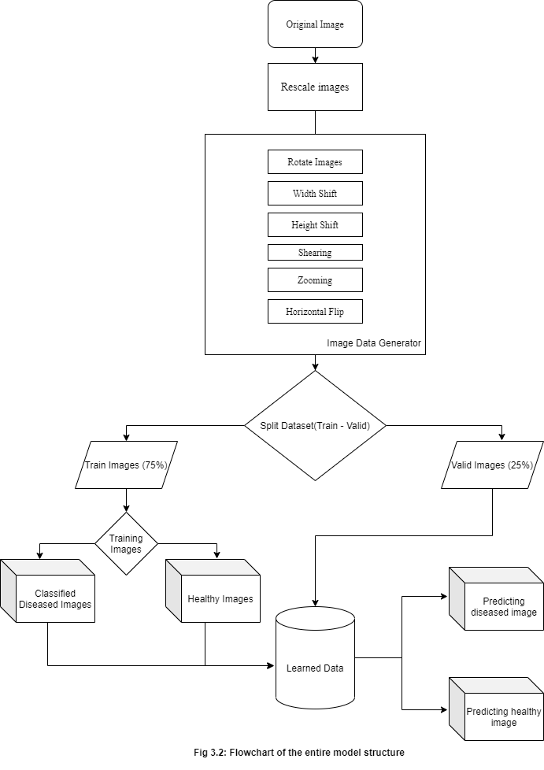
Research methodology

Slide 10
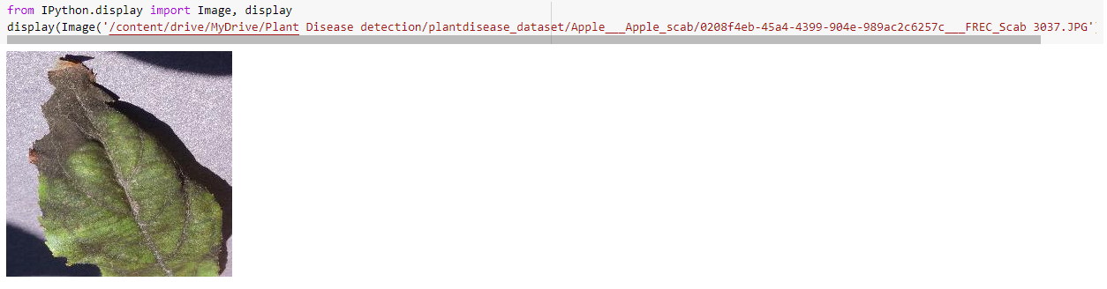
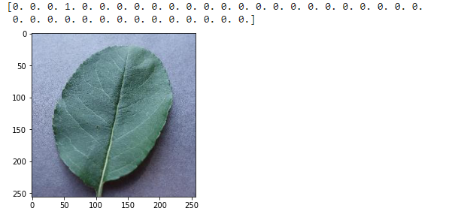
Image preprocessing
Fig 2: Images Before Preprocessing.
Fig 3: Images After Preprocessing.

Slide 11
Test-train split using xception
Model | Accuracy | Size
Xception(epoch-100) 0.2%Test & 0.8% Train | 99.13% | 88mb
Xception(epoch-100) 0.4%Test & 0.6% Train | 99.22% | ,,
Xception(epoch-100) 0.6%Test & 0.4% Train | 98.625% | ,,
Xception(epoch-100) 0.8%Test & 0.2% Train | 98.32% | ,,

Slide 12
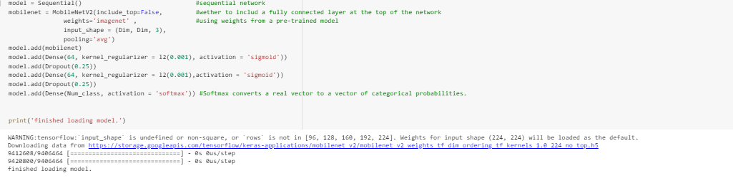
Mobilenetv2 explained
Fig 5.11.1: Calling MobileNetV2 pretrained model from Google Colab..

Slide 13
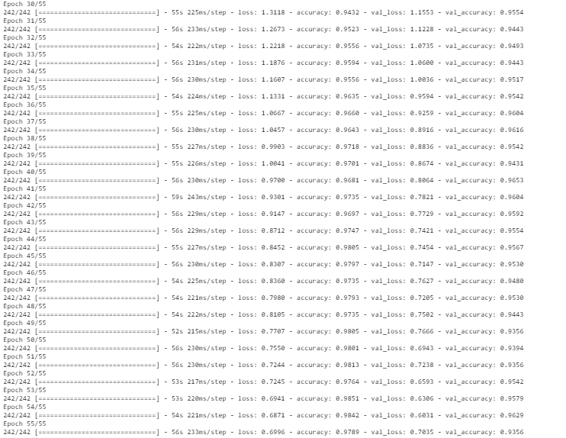
Running epochs
Fig 5.11.3: Running epochs in MobileNetV2 model.

Slide 14
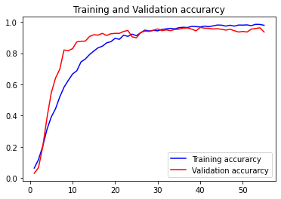
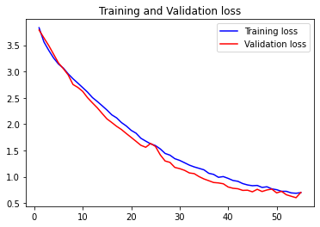
Accuracy and loss graph
Fig 5.11.4: Accuracy and Loss graph in MobileNetV2 model.

Slide 15
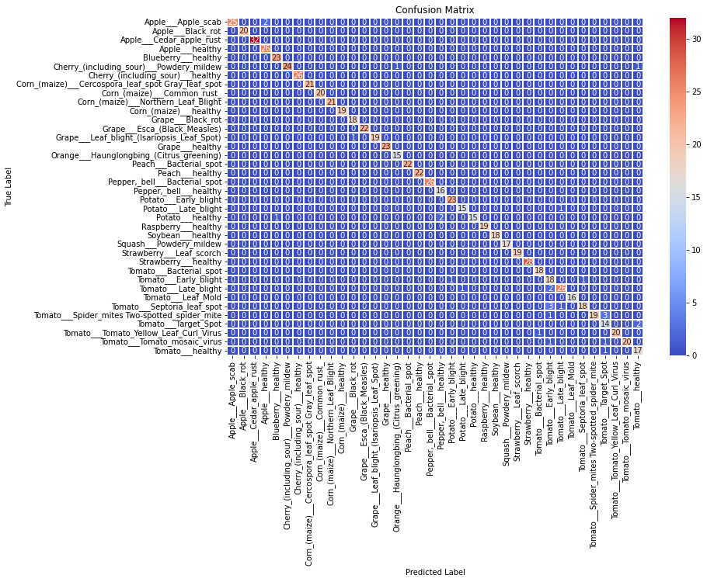
Confusion matrix
Fig 5.11.5: Confusion Matrix for 38 classes in MobileNetV2 model.

Slide 16
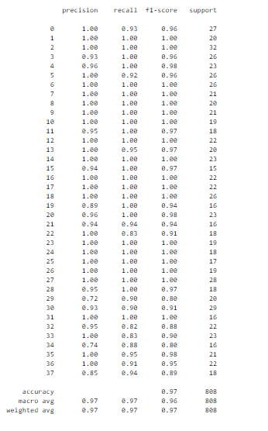



Precision, recall and f1 score
Precision = $\frac{True positive}{True positive+False positive}$
Recall = $\frac{True positive}{True positive+False negetive}$
F1 Score = 2* $\frac{Recall ∗Precision }{Recall+Precision}$
Fig 5.11.6: Precision, Recall and F1 score for 38 classes in MobileNetV2 model.

Slide 17
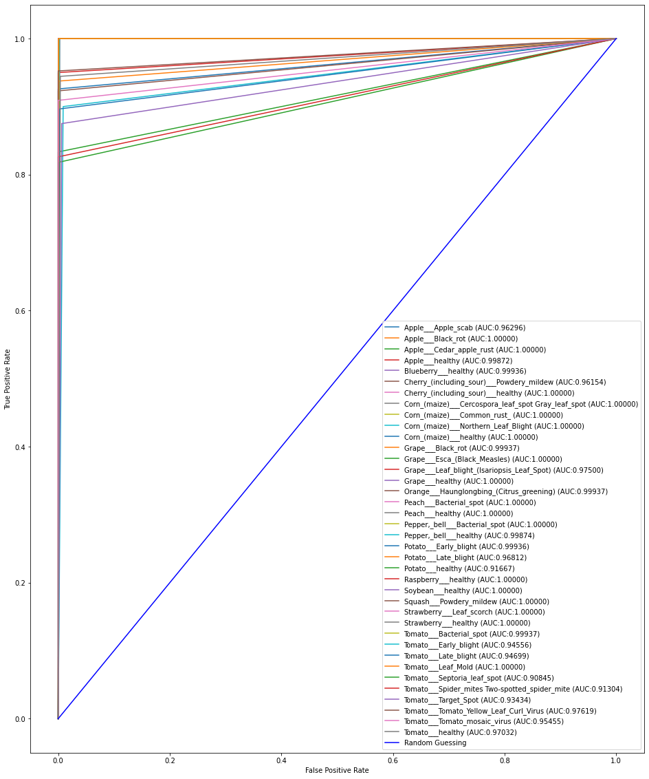
roc Auc score
Fig 5.12.7: ROC AUC score for 38 classes in MobileNetV2 model.

Slide 18
summery
Deep learning Architecture | Parameters (in million) | Epoch required | Training Accuracy | Validation Accuracy | Training Loss | Validation Loss | Precision | Recall | F1-Score
VGG16 | 138M | 55 | 98.76 | 91.46 | 0.04 | 0.41 | 0.92 | 0.91 | 0.91
VGG19 | 138M | 55 | 96.47 | 90.23 | 0.14 | 0.47 | 0.91 | 0.90 | 0.90
ResNet50 | 23.6M | 55 | 98.55 | 95.67 | 0.04 | 0.16 | 0.97 | 0.96 | 0.96
InceptionV3 | 41.2M | 55 | 66.32 | 77.60 | 1.12 | 2.00 | 0.80 | 0.77 | 0.77
MobileNetV2 | 3.2M | 55 | 98.51 | 96.53 | 0.62 | 0.59 | 0.97 | 0.97 | 0.96
Xception | 22.8M | 55 | 98.84 | 96.41 | 0.00 | 0.01 | 0.97 | 0.96 | 0.96
Table 5.1: Precision, Recall, F1-Score, Accuracy, Loss of Different Deep learning architecture

Slide 19
conclusion
Pre-trained models have been greatly used in machine learning and computer vision applications also including plant disease identification.
The main purpose of this system is to improve the efficiency of the automatic plant disease detection.
Experimental results show that the proposed system can successfully detect and classify the plant disease with accuracy of 96.41%.
In future work, we will extend our database for more plant disease identification and use large number of data as training data as training purpose in classification.

Slide 20
Refferences
1. Sastry, K.S.: Plant Virus and Viroid Diseases in the Tropics, vol. II. Springer,Heidelberg (2013)
2. Krizhevsky, A., Sutskever, I., Hinton, G.E.: ImageNet classification with deep convolutional neural networks. In: Advances In Neural Information Processing Systems,pp. 1–9 (2012)
3. Hall, D., McCool, C., Dayoub, F., Sunderhauf, N., Upcroft, B.: Evaluation of features for leaf classification in challenging conditions. In: 2015 IEEE Winter Conference on Applications of Computer Vision, pp. 797–804 (2015)
4. Jin, J., Fu, K., Zhang, C.: Traffic sign recognition with hinge loss trained convolutional neural networks. IEEE Trans. Intell. Transp. Syst. 15, 1991–2000 (2014)
5. Kutty, S. B., Abdullah, N. E., Hashim, H., Kusim, A. S., Yaakub, T. N. T., Yunus, P. N. A. M., & Abd Rahman, M. F. (2013, April). Classification of watermelon leaf diseases using neural network analysis. In2013 IEEE Business Engineering and Industrial Applications Colloquium (BEIAC)(pp. 459-464). IEEE.
6. Sannakki, S. S., Rajpurohit, V. S., Nargund, V. B., & Kulkarni, P. (2013, July). Diagnosis and classification of grape leaf diseases using neural networks. In2013 Fourth International Conference on Computing, Communications and Networking Technologies (ICCCNT)(pp. 1-5). IEEE.
7. Akhtar, A., Khanum, A., Khan, S. A., & Shaukat, A. (2013, December). Automated plant disease analysis (APDA): performance comparison of machine learning techniques. In2013 11th International Conference on Frontiers of Information Technology(pp. 60-65). IEEE.
8. Oo, Y. M., & Htun, N. C. (2018). Plant leaf disease detection and classification using image processing.International Journal of Research and Engineering,5(9), 516-523.
9. Oo, Y. M., & Htun, N. C. (2018). Plant leaf disease detection and classification using image processing.International Journal of Research and Engineering,5(9), 516-523.
10. Gavhale, K. R., & Gawande, U. (2014). An overview of the research on plant leaves disease detection using image processing techniques.IOSR Journal of Computer Engineering (IOSR-JCE),16(1), 10-16.
11. Tajane, Vinita, and N. J. Janwe. 2014. Medicinal Plants Disease Identification Using Canny Edge Detection Algorithm, Analysis and CBIR. International Journal of Advance Research in Computer Science and Software Engineering. 4(6): 530-536.
12. Mohanty, S. P., Hughes, D. P., & Salathé, M. (2016). Using deep learning for image-based plant disease detection.Frontiers in plant science,7, 1419.

